Slide 1

Computational Social Science Proposal
Katie Widner Sanchez
June 6, 2023

Slide 2
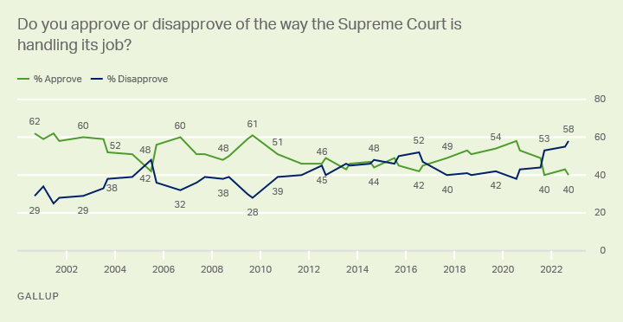
Puzzle

Slide 3
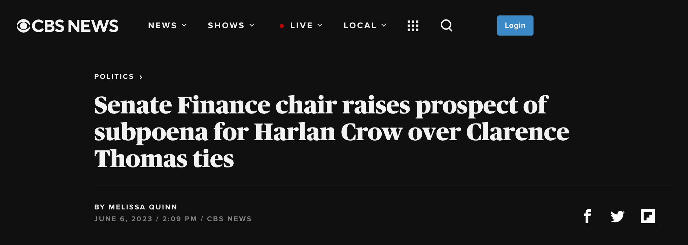
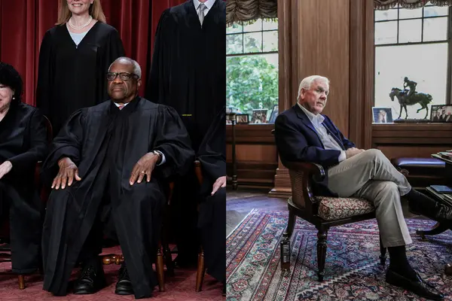
Puzzle
Image via Pro Publica

Slide 4
Research Question
What is the nature of public opinion of the US Supreme Court? To what extent is legitimacy a frame in evaluations of the Court?

Slide 5
Theory
The Supreme Court is highly ideological (Segal and Spaeth 2002; Gibson 2015)
The Court lacks an electoral connection (Caldeira 1992)
Justices are appointed for life and face little accountability
The Court lacks enforcement mechanisms (Rosenberg 2008)
The Court needs diffuse support to function (Bartels 2012)
Central tension: The Supreme Court is an ideological institution which needs diffuse public support to operate; this public support hinges on the idea that the Court is apolitical or “above” partisan politics

Slide 6
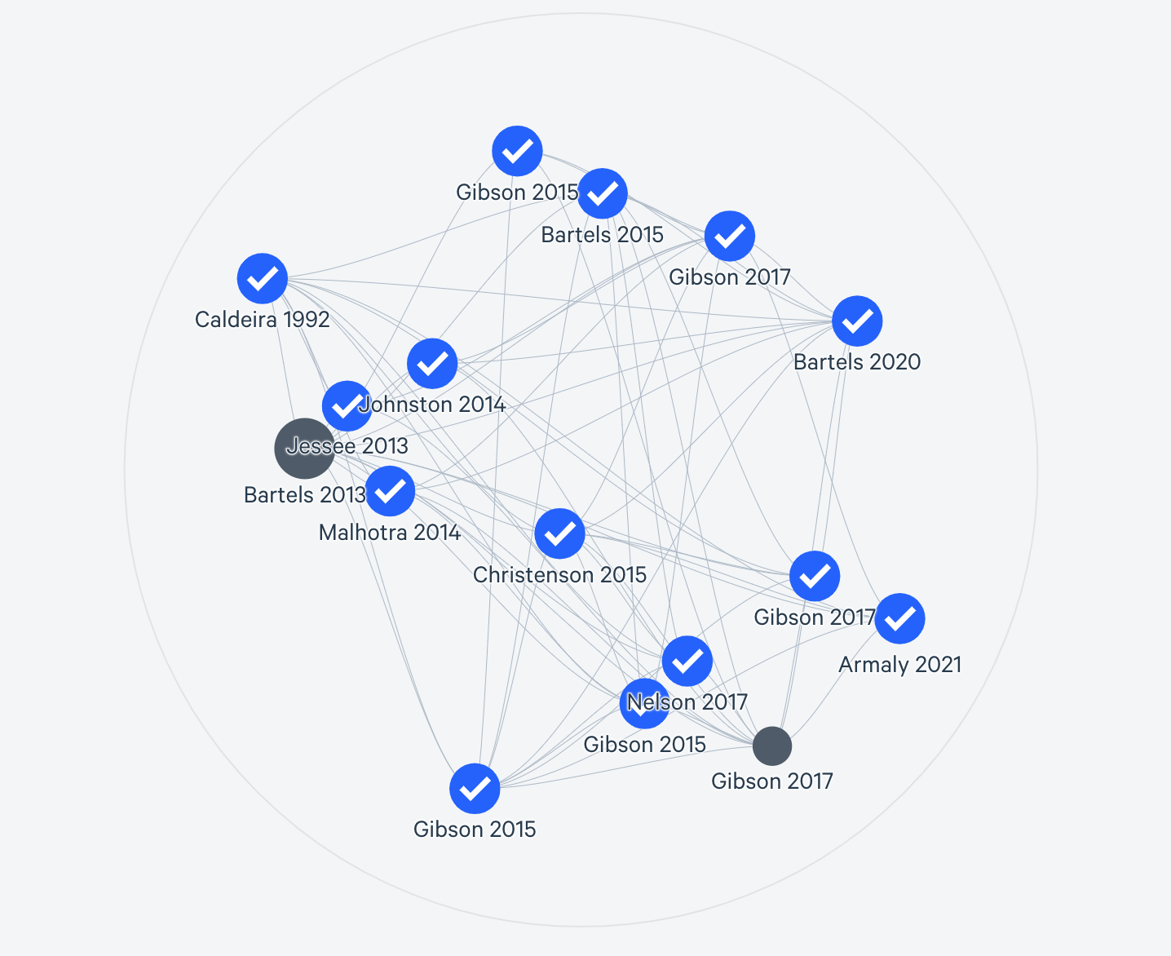
Literature
Image via Litmaps

Slide 7
Empirical Design
Text analysis of New York Times op-ed coverage of Supreme Court
Principal component analysis → latent semantic analysis
What components explain the variability in New York Times op-ed coverage of the United States Supreme Court over the past three years?
What frames emerge when examining these articles?
Which terms are most frequently utilized?

Slide 8
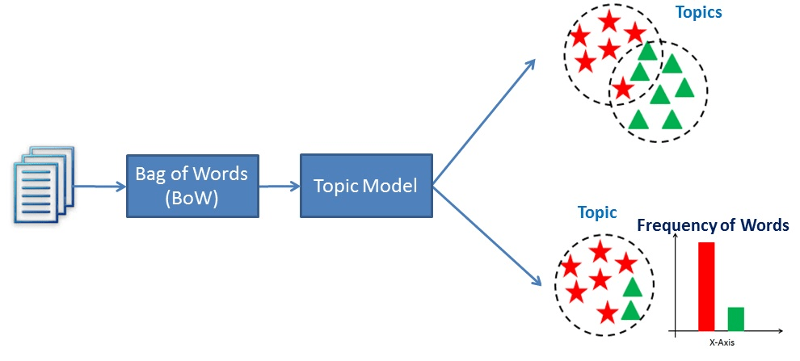
Latent Semantic Analysis
Image via Data Camp

Slide 9
Next Steps
Pull data from New York Times API
Clean data
Pre-process (create tokens, remove stems)
Perform analysis
Continue developing project next semester in Dr. Cordell’s course

